Slide 1
INFO3111: C++ Graphics
Day 11
Texturing (part 1 of…) (2D texturing)

Slide 2

X,Y,Z (W)
0,1
0.5,1
1,1
S, T, U
U, V, W
Y (t, v)
0,1
0.5,1
1, 1
0.5,0.5
0,0
1,0
0.5,0.5
X (s,u)
RGBA
0,0
1,0

Slide 3
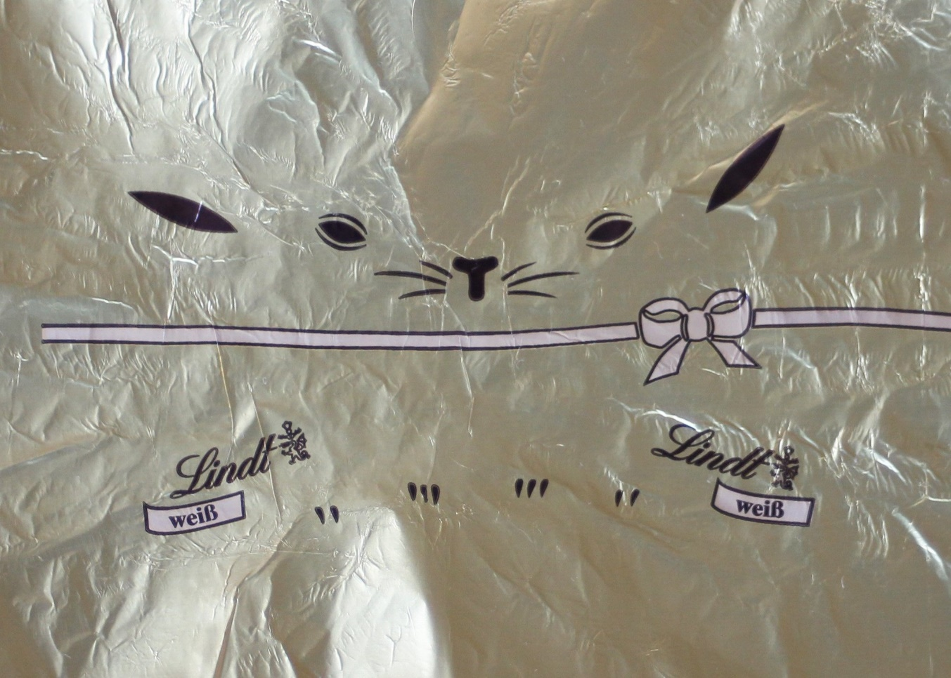
+2047,
+1461
Y axis
0 to 1461
0,0
X Axis (0 to 2047

Slide 4
+2047,
+1461
1.0, 1.0
Y axis
0 to 1461
0.0 to 1.0
OpenGL: s, t
DirectX: u, v
0,0
X Axis (0 to 2047, 0.0 to 1.0

Slide 5




Texture array (C++)
Texture in GPU RAM
Copy to GPU
Loader
Texture file(BMP)
MIP map

Slide 6
Texture in GPU RAM
(“SydneySweeny”)
Texture #27
Fragment shader
Sampler 0A
Sampler 0B
Texture in GPU RAM
(fouci)
Sampler 0C

Slide 7
Fragment shader
Texture in GPU RAM
(Syndey)
GL_TEXTURE0
Texture “Units” 0
0
Sampler2D texture00
Texture “Units” 21
Texture “Units” 2
Sampler texture01
Texture in GPU RAM 4
(sloth)
Texture “Units” 3
Sampler texture02
samplerCube texture02
glActiveTexture(GL_TEXTURE3 );
glBindTexture( GL_TEXTURE_2D, 17 );
glUniform1i( UniformLoc_Sampler02, 3);

Slide 8
Sophie T Texture in GPU RAM:
1
Texture Units 0
Fragment shader: Sampler variable;
Sampler 0
If you only create ONE texture and bind ONE texture and have only ONE sampler, OpenGL will automatically “hook you up”, setting all the things to “0”:
Texture 0
Binding point 0
Active Texture 0
Sampler 0

Slide 9
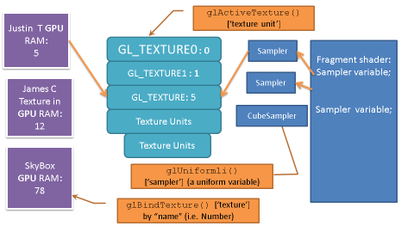
glActiveTexture() [‘texture unit’]
Justin T GPU RAM:
5
GL_TEXTURE0 : 0
Sampler
Fragment shader: Sampler variable;
Sampler variable;
GL_TEXTURE1 : 1
Sampler
James C Texture in GPU RAM:
12
GL_TEXTURE: 5
Texture Units
CubeSampler
Texture Units
SkyBox
GPU RAM:
78
glUniform1i()
[‘sampler’] (a uniform variable)
glBindTexture() [‘texture’] by “name” (i.e. Number)

Slide 10



Video card
CPU RAM
Video Card
VRAM
texSophie
5
TextureUnit_0
texTheRock
TextureUnit_1
Texture_Unit_2
texWhatever
8
17

Slide 11
Grass
Texture in GPU RAM:
1
MeshObject
Brick (0.6)
Grass (0.4)
GL_TEXTURE0
Sampler0
Weight0
GL_TEXTURE1
Sampler1
Weight1
Brick
Texture in GPU RAM:
2
Texture Units
Sampler1
Weight2
Justin
Texture in GPU RAM:
3

Slide 12
Basic process, inside the shader:
// Note: it’s the SAMPLER that determines the type of texture
// (1D, 2D, 3D, cube, etc.)
uniform sampler2D texSamp2D_00;
// Later, when actually “sampled”...
vec4 diffuse0 = texture( texSamp2D_00, text_STU.xy ).rgba;
vec4 diffuse1 = texture( texSamp2D_01, text_STU.xy ).rgba;
vec4 diffuse2 = texture( texSamp2D_02, text_STU.xy ).rgba;

Slide 13
How to manage this? A few ways...
Could “switch” textures for each object
Is (somewhat) expensive, worth drawing everything with the same texture together
Catch: what if there’s a combination of textures and there isn’t a clear “1st texture” to draw?

Slide 14
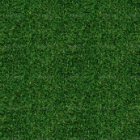
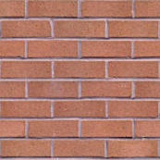
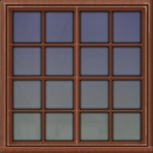
How to manage this? A few ways...
Could pre-process the textures so that they are all in one texture.
Let’s say you combine grass + brick + window textures.
Instead of loading 3 textures individually, you could combine them into 1 texture (like in photoshop/Blender/whatever) and alter the texture coordinates to refer to this one texture
This is ONE image, not 3

Slide 15
How to manage this? A few ways...
Or, you could just load all (or most of) the textures for a scene and select them in the shader. You could do this two ways:
Have a swtich/if statement, passing values to indicate which ones you want, or
Have ‘blend’ values being passed, indicating how much of each texture contributes
Or a combination of the two
Pssst!: This is what we are going to use...

Slide 16
Basic process:
GLuint texture00Number = ::g_pTextureManager->getTextureIDFromName(“cobblestone.bmp");
// Texture binding...
GLuint texture00Unit = 0; // Texture unit go from 0 to 79
glActiveTexture( texture00Unit + GL_TEXTURE0 ); // GL_TEXTURE0 = 33984
glBindTexture( GL_TEXTURE_2D, texture00Number );
// glBindTextureUnit( texture00Unit, texture00Number ); // OpenGL 4.5+ only
// Set texture unit in the shader, too
glUniform1i( UniformLoc_texSamp2D_00, texture00Unit );
GLuint texture01Number = ::g_pTextureManager->getTextureIDFromName("brickTexture_square_1024pixels.bmp");
GLuint texture01Unit = 1; // Texture unit go from 0 to 79
glActiveTexture( texture01Unit + GL_TEXTURE0 ); // GL_TEXTURE0 = 33984
glBindTexture( GL_TEXTURE_2D, texture01Number );
// glBindTextureUnit( 1, texture01Number ); // OpenGL 4.5+ only
// Set texture unit in the shader, too
glUniform1i( UniformLoc_texSamp2D_01, texture01Unit );
...and so on...

